Slide 1
Brick Breaker Game
SUBMITTED BY,
IYSWARIYA G

Slide 2
AGENDA
Project Description
Introduction
Software Requirements
High Level Approach
Functions
Visual Representations
Conclusion

Slide 3
PROJECT DESCRIPTION
Display bricks and disappear after hitting the ball.
Small platform moving left and right.
The ball must bounce after hitting brick and platform at the bottom.
Score display

Slide 4
INTRODUCTION
Brickbreaker game is a widely used game which was developed in the 1970s.
In Brick Breaker, a layer of bricks lines the top third of the screen and the goal is to destroy them all.
A ball moves straight around the screen, bouncing off the top and two sides of the screen.

Slide 5
SOFTWARE REQUIREMENTS
CONCEPTS USED:
a)Eclipse
OPERATING SYSTEM:
a)Windows 11

Slide 6
HIGH LEVEL APPROACH
Design the window where the game needs to be framed.
Design the entire gameplay(background,bricks,ball,paddle).
Implement the actions of the keys (to move the paddle sideways).
Implement the action performed by the ball on the bricks and paddle.

Slide 7
Functions
In this game,has one paddle,one ball and some bricks.I have created an image for a ball,paddle and a brick using java program.I use a timer to create a game cycle.
We do not work with angles,we simply change directions.Top,bottom,left and right.

Slide 8
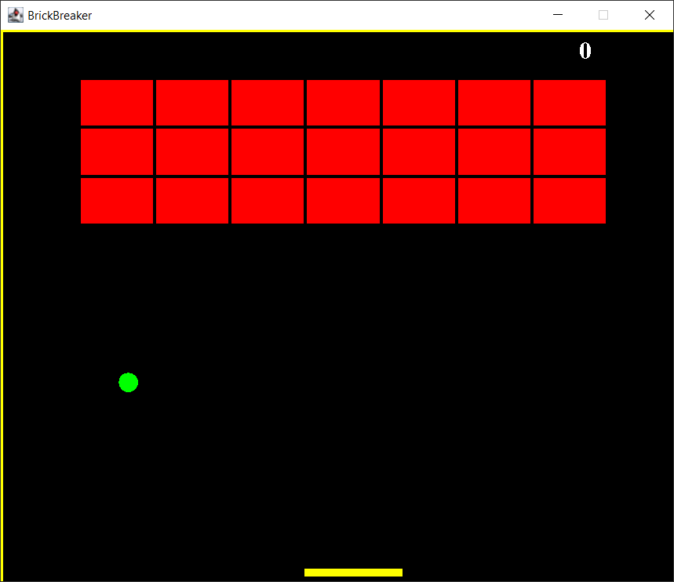
VISUAL REPRESENTATION

Slide 9
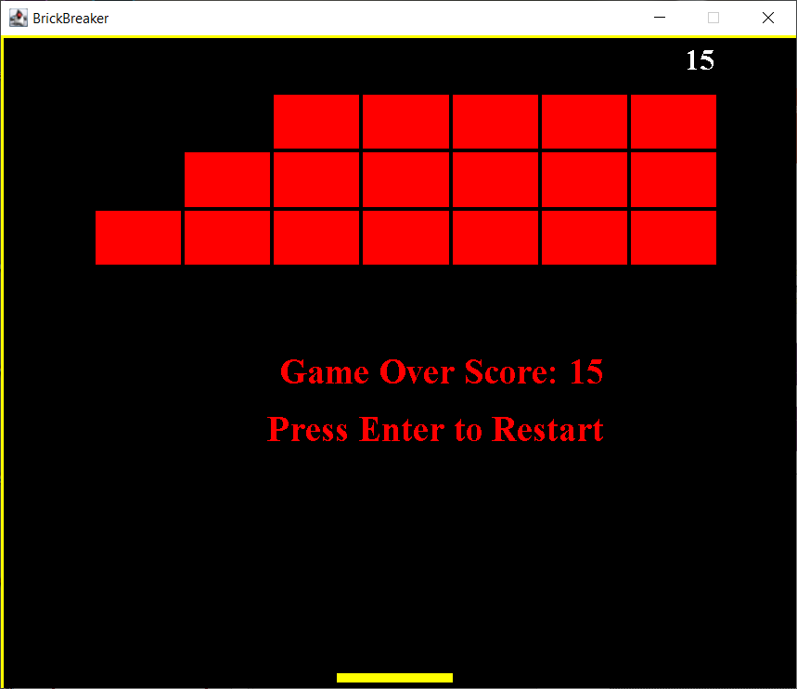

Slide 10
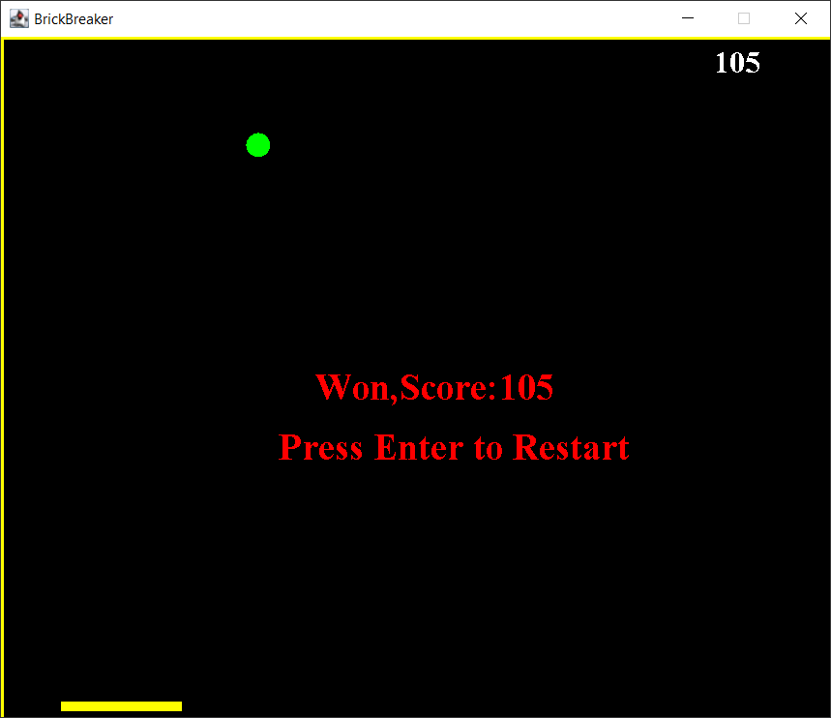

Slide 11
CONCLUSION
All the levels of the Brick Breaker game are different from each other.Once you start playing Brick Breaker game,you will love playing it again and again.You can also share this game to your friends and family members.People enjoy a lot playing Brick Breaker.
They feel refreshed after playing this game.

Slide 12


